Slide 1

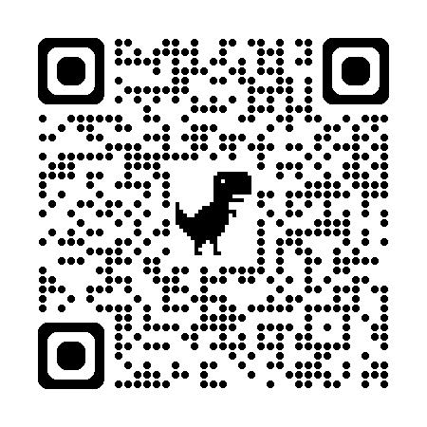











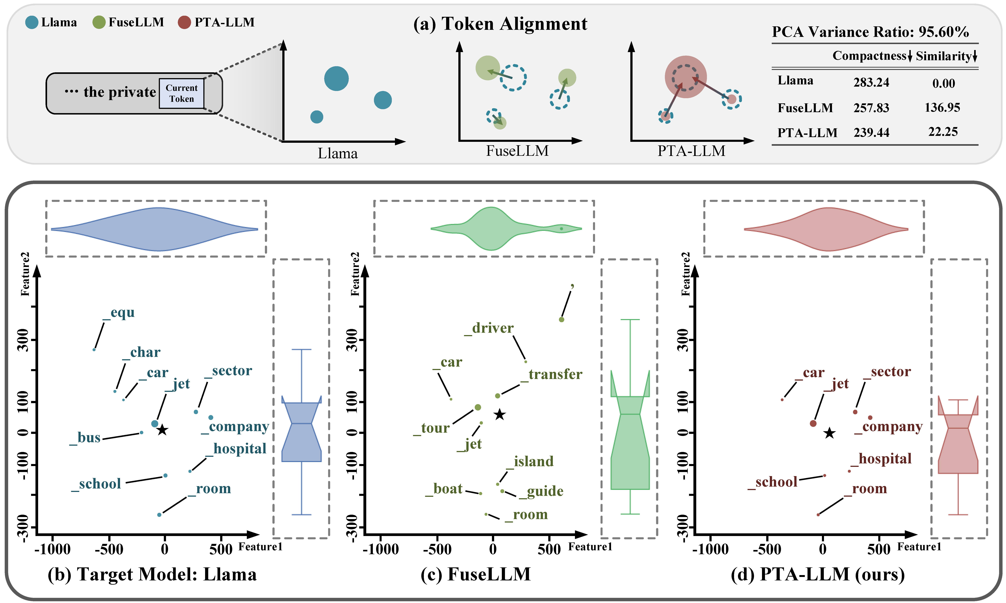

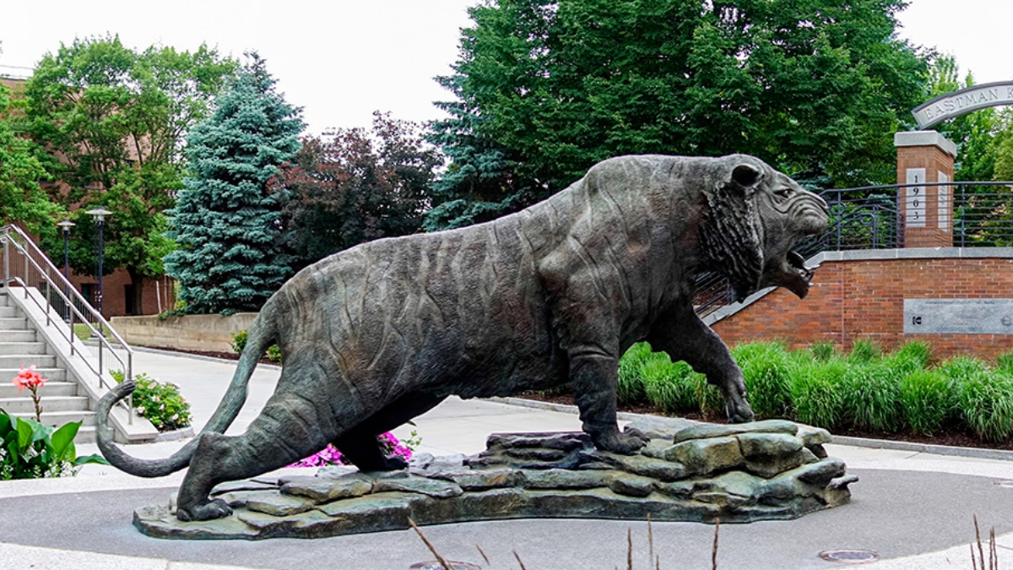
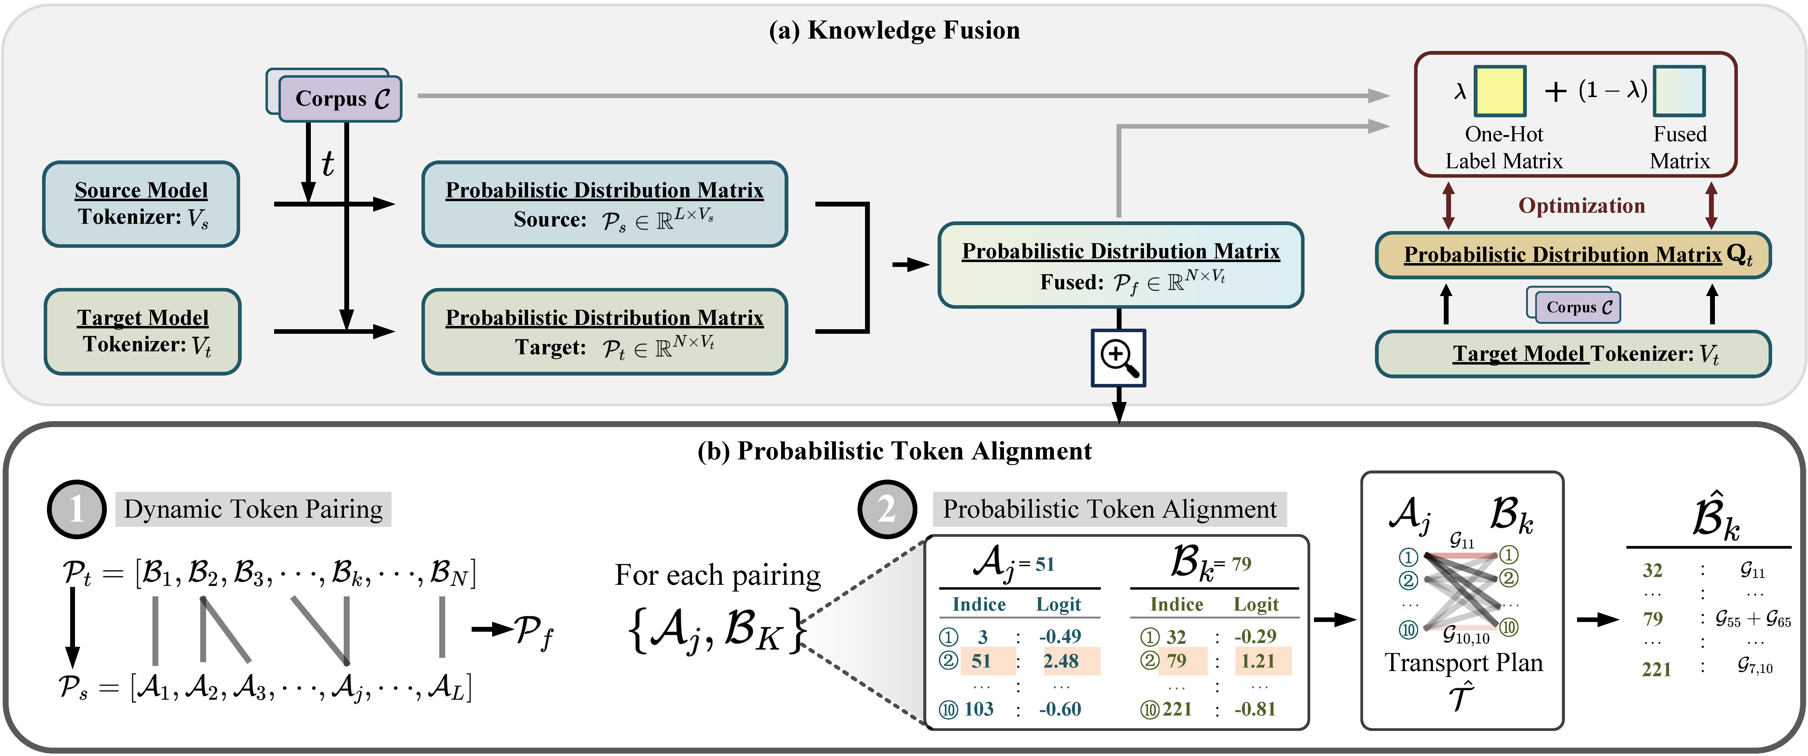

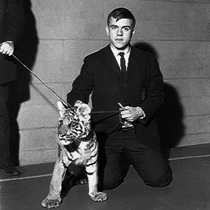


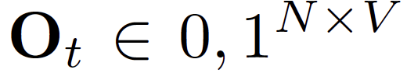
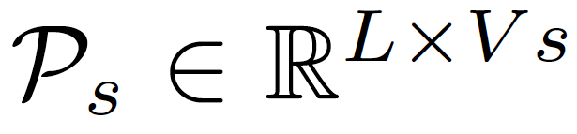
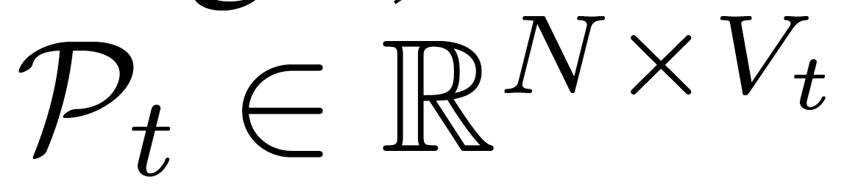
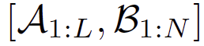
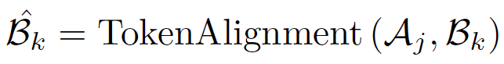
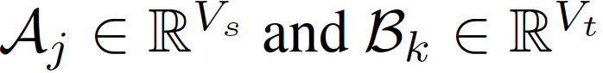
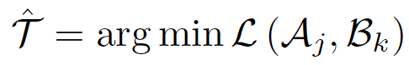
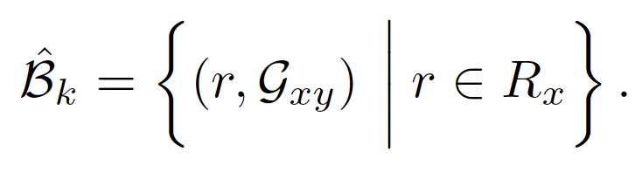
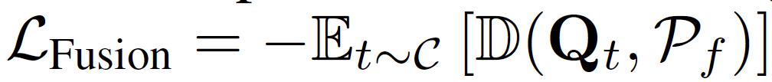

Probabilistic Token Alignment for Large Language Model Fusion
Runjia Zeng¹, James Chenhao Liang², Cheng Han³,
Zhiwen Cao⁴, Jiahao Liu⁵, Xiaojun Quan⁶, Yingjie Victor Chen⁷,
Lifu Huang⁸, Tong Geng^{9, 10}, Qifan Wang¹¹, Dongfang Liu^{1†}
¹Rochester Institute of Technology ²U.S. Naval Research Laboratory
³University of Missouri-Kansas City ⁴Adobe ⁵Meituan ⁶Sun Yat-sen University ⁷Purdue University ⁸UC Davis ⁹University of Rochester ¹⁰Rice University ¹¹Meta AI †Corresponding author
Introduction
Abstract
Training large language models (LLMs) from scratch can yield models with unique functionalities and strengths, but it is costly and often leads to redundant capabilities. A more cost-effective alternative is to fuse existing pre-trained LLMs with different architectures into a more powerful model. However, a key challenge in existing model fusion is their dependence on manually predefined vocabulary alignment, which may not generalize well across diverse contexts, leading to performance degradation in several evaluation. To solve this, we draw inspiration from distribution learning and propose the probabilistic token alignment method as a general and soft mapping for alignment, named as PTA-LLM. Our approach innovatively reformulates token alignment into a classic mathematical problem: optimal transport, seamlessly leveraging distribution-aware learning to facilitate more coherent model fusion. Apart from its inherent generality, PTA-LLM exhibits interpretability from a distributional perspective, offering insights into the essence of the token alignment. Empirical results demonstrate that probabilistic token alignment enhances the target model's performance across multiple capabilities. Our homepage (code, slides and video) is at runjia.tech/neurips_pta-llm.
Main Results
The rise of large language models (LLMs) driven by scaling laws, has yielded significant advancement across a broad range of tasks. Nevertheless, the reliance on scaling laws brings substantial computational demands, posing a noticeable impediment to the development of more robust baselines. A question thus naturally emerges:
Question 1
How an we construct stronger baselines without resorting to the naive application of scaling laws?
Pioneering research has begun to address this question through the concept of model fusion, focusing on model ensemble and weight merging. Recently, a prominent technique called knowledge fusion aggregates the probabilistic distributions generated by individual LLMs and transfers this fused representation to a target model via distillation, enabling it to be more inference-efficient. After further employing token alignment, the misalignment issues arising from the use of different tokenizers across models are mitigated, allowing knowledge fusion to be architecture-agnostic. The exemplary advantages offered by knowledge fusion reframe question ① into ②:
1
2
Question 2
The global probabilistic distribution transport enhances the coherence of the representations, thereby improving the model's ability to generalize across a wide range of tasks and supporting the transfer of underlying representations for effective evaluation.
The reframing through an optimal transport perspective introduces a soft probabilistic alignment, offering a flexible and adaptive solution to diverse contexts and performing stablly even in difficult tasks.
How can we further optimize LLMs through knowledge fusion?
Visualizations
Although knowledge fusion shows a promise avenue, two significant token alignment challenges still remain unresolved. ❶ The manually designed mapping strategy is overly simplistic, failing to capture the intricate patterns within the data. Tokens appearing in varying contexts often align with different objectives, and the bias introduced by this ‘rigid’ alignment reduces the model‘s capacity to fully learn from the data, ultimately diminishing performance. ❷ The alignment of top-k predicted token sets from the source and target LLMs is performed independently, without taking into account their associated probabilities or overall distribution. This isolated strategy may achieve local optimality at each step alignment, but not a whole coherent fused metric. Thus, question ② becomes more specific:
3
*This "SpiRIT" is generated by Midjourney with the prompt refined from ChatGPT-5.
The effectiveness of our approach is supported by theoretical insights from distribution learning and further validated through visualization results. It investigates the underlying mechanisms of token alignment, a critical operation in knowledge fusion that has been largely overlooked in prior research.
Question 3
How can we effectively fuse LLMs with an adaptive and coherent matrix?
PTA-LLM
The "SpiRIT" statue is located right at the center of RIT campus.
RIT once had a real tiger!
Understanding of Optimal Transport:
Given we have previously aligned tokens like 'the private,' we need to align the token pair from the source model and target model to form the next fused token. For tokens from the target model, we can visualize their top-10 logits and corresponding indices in a 2D space (see (a), left coordinate, showing only 3 logits in a high-level representation). This is done by first using the target model's tokenizer to extract token features, followed by dimensionality reduction using Isomap and PCA. Their relative position can reflect the underlying meaning of this indice, and the relative size indicates the magnitude of their corresponding logit. For FuseLLM, traditional hard mapping does not consider their logit and maps each indice to another with a pre-defined strategy, acting like a 'moving' (i.e., change the location without modifying the size) in high-level understanding. In contrast, PTA-LLM leverages the complete distribution, 'transporting' (i.e., distribute the size into current location) the optimal logit into existing indices. Quantitatively, we further compute the average compactness of each token (i.e., the logit-weighted Euclidean distance from each point to its center) and the similarity of each token center to the target one (i.e., the Euclidean distance from each center point to the target one) in 100 random samples, as shown in the table in (a). It empirically demonstrates that our method generates a more coherent fused token, as evidenced by a more compact representation and a more consistent representation.
Case Studies:
As shown in the down part of the figure, we can visually compare the distribution of PTA-LLM fused token with the target token and FuseLLM fused token. Specifically, a more consistent marginal feature distribution between PTA-LLM and target token can be observed from (b) and (d), where FuseLLM exhibits significantly greater distortion in the overall token representation. The more compact and coherent overall token distribution after employing probabilistic token alignment is aligned with the quantitative results.
One-hot label:
Traditional CLM loss:
Probabilistic distribution matrices for the source and target models:
Dynamic Token Pairing: Formally, given two sequences of tokens , our objective is to find an alignment through dynamic programming that minimizes the overall cost associated with transforming one sequence into the other.
Probabilistic Token Alignment: After finding the pairing ,
Token-level alignment:
Transform into the optimal transport problem:
Knowledge fusion loss:
Our loss:

